Slide 1
Optimizing Performance: Three- Tier Architecture Setup with VPC, EC2, and RDS
TEAM MATES: 2100039123– P anvar

Slide 2

This presentation discusses optimizing performance using a Three-Tier Architecture setup with ALB, EC2, and RDS. We will explore the beneﬁts of this architecture and how it enhances scalability and reliability.

Slide 3
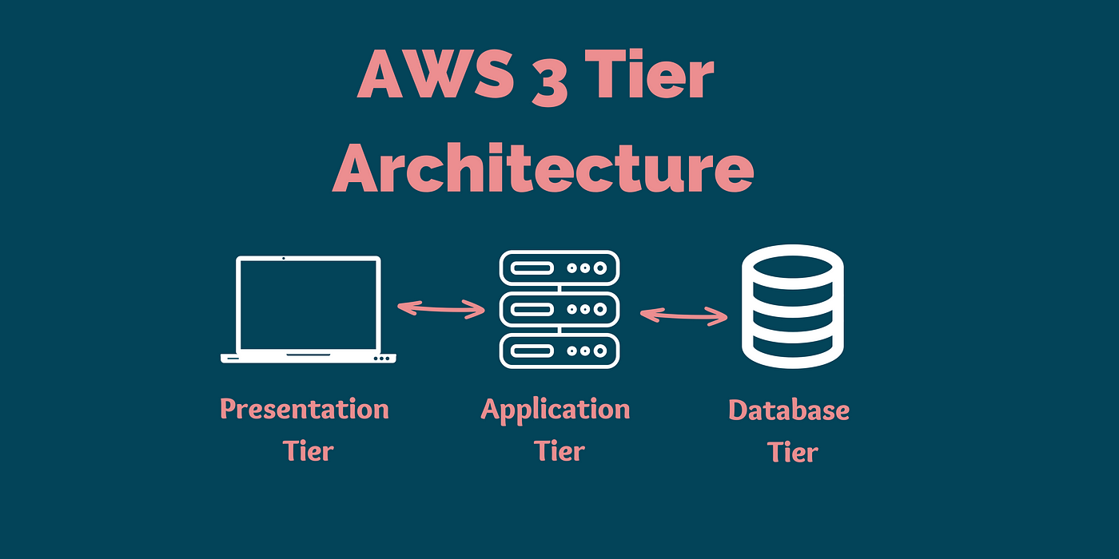
Description:
In a three-tier architecture with ALB, EC2, and RDS on AWS, optimize performance by configuring ALB for load balancing and health checks, utilizing Auto Scaling for EC2 instances, implementing caching and CDN for content delivery, optimizing database parameters and queries in RDS, monitoring with CloudWatch, conducting performance testing, and ensuring security and compliance with AWS best practices.

Slide 4
Prerequisites:
Creating virtual private cloud(VPC)
Creating Route table in VPC services
Creating subnet, Internet gateway in VPC services.
Creating instance and database by using php.
Creating Load balancer.
Create RDS and check the connection.

Slide 5
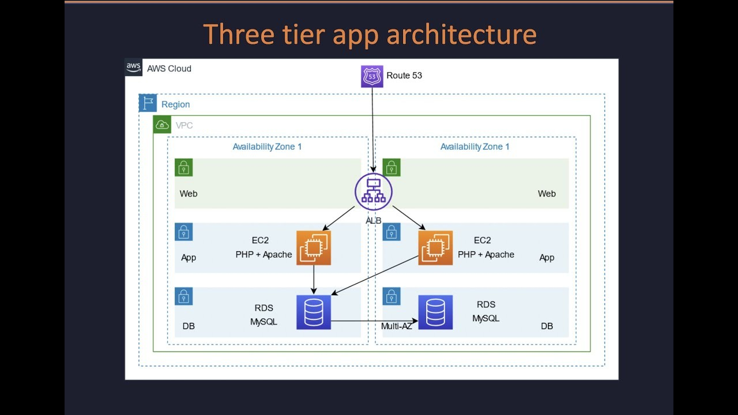
Architecture Design

Slide 6
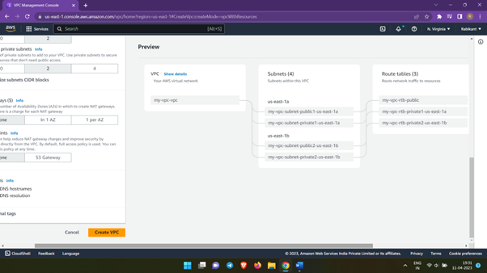
VPC’s A VPC is a virtual network that closely resembles a traditional network that you'd operate in your own data center

Slide 7
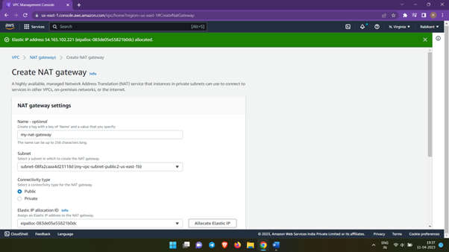
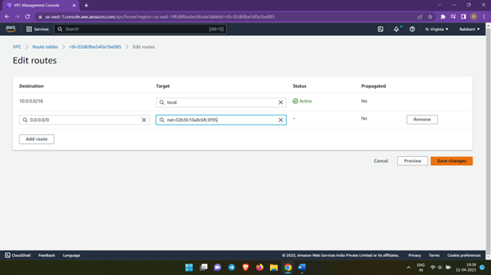
Virtual Private Cloud(VPC's) services
Creating Subnet
Route table
Internet Gateway

Slide 8
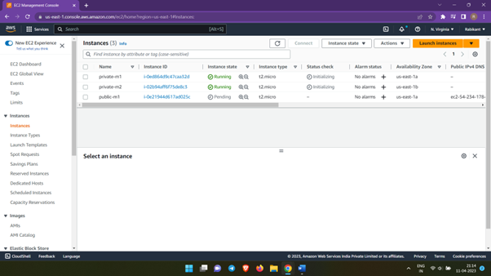
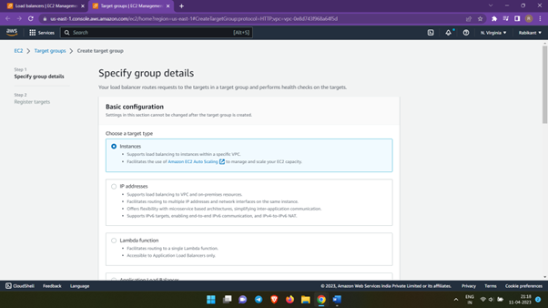
EC2
Creating an instance
Creating target group
Amazon Elastic Compute Cloud (Amazon EC2) is a web service that provides secure, resizable compute capacity in the cloud. It is designed to make web-scale cloud computing easier for developers. Amazon EC2's simple web service interface allows you to obtain and configure capacity with minimal friction.

Slide 9
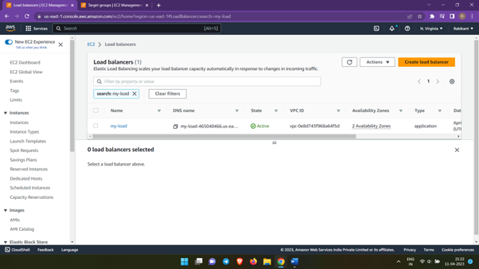
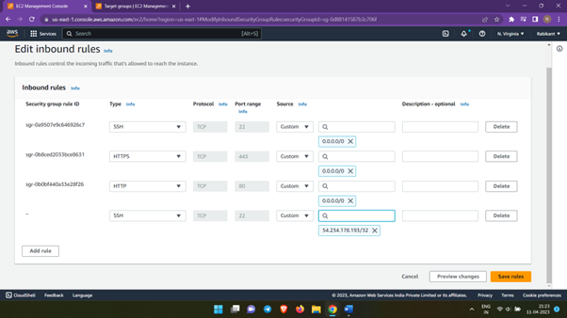
Creating Load balancer
Edit Inbound Rules

Slide 10
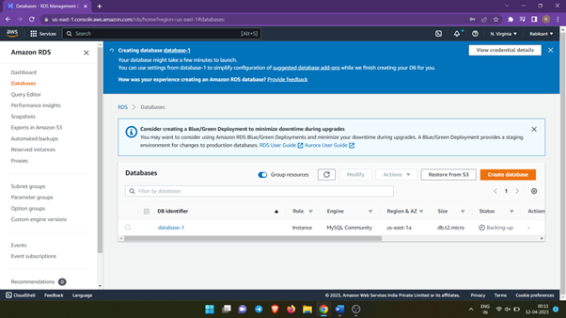
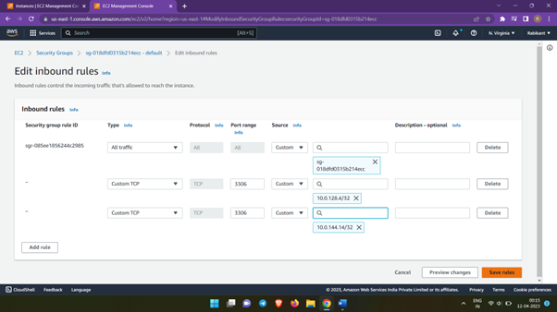
RDS
Amazon Relational Database Service (Amazon RDS) is a collection of managed services that makes it simple to set up, operate, and scale databases in the cloud.

Slide 11
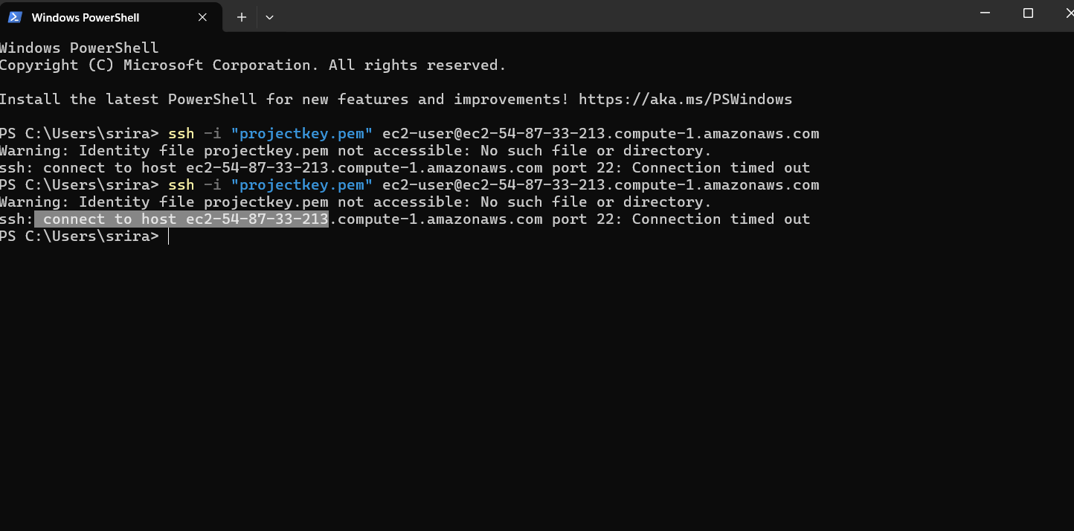
Check the Connection

Slide 12

Conclusion
In conclusion, the three-tier architecture setup with ALB, EC2, and RDS offers a robust foundation for optimizing performance. By leveraging best practices, security measures, and scalability strategies, organizations can achieve high availability, reliability, and scalability for their applications.

Slide 13
Thanks!
LinkedIn Links:
2100039123 :https://www.mygreatlearning.com/academy/courses/11455207/65459#?utm_source=share_with_friends&gl_source=share_with_friends
YouTube:
2100039121 :
GitHub:
2100039121 :
PPT Presentation:
https://kluniversityin-my.sharepoint.com/:p:/g/personal/2100039121_kluniversity_in/Ef5zKZk_JWZPviQhkkyCMT8BUBhh1Sd413xbdzBkfxtW6w?e=UyG017

